Slide 1
ASSIGNMENT-01 UPLOADING THE DATASET TO COGNOS ANALYTICS, EXPLORING & VISUALIZING THE DATASET DATASET-50 STARTUP DONE BY, AISHWARYALAKSHMI B 7376191EC107 BE ECE BANNARI AMMAN INSTITUTE OF TECHNOLOGY

Slide 2
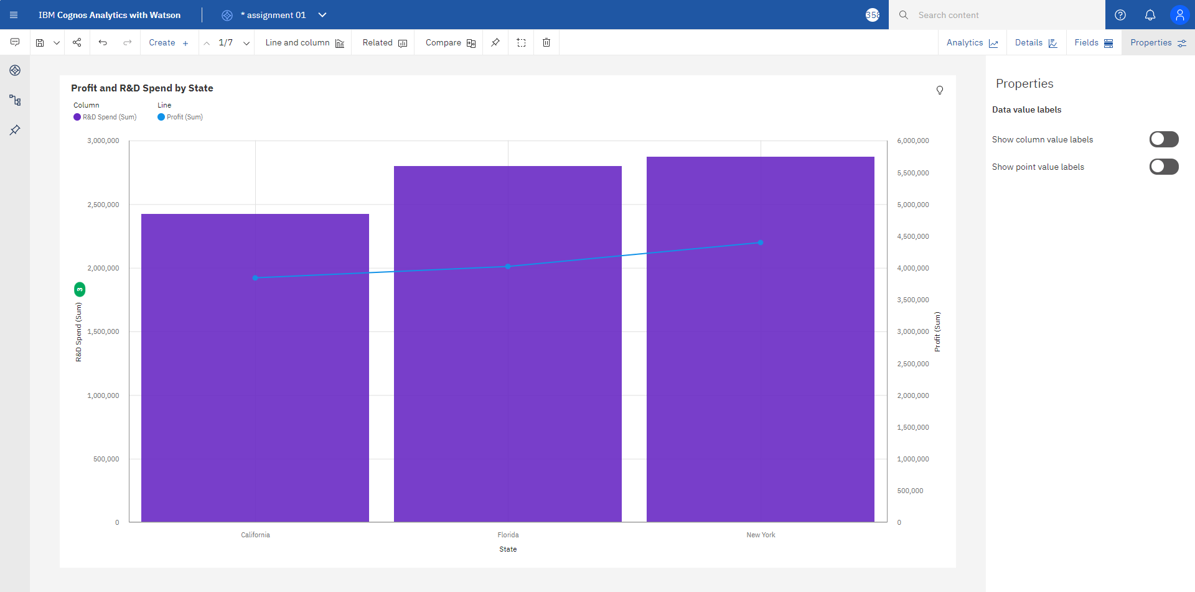

Slide 3
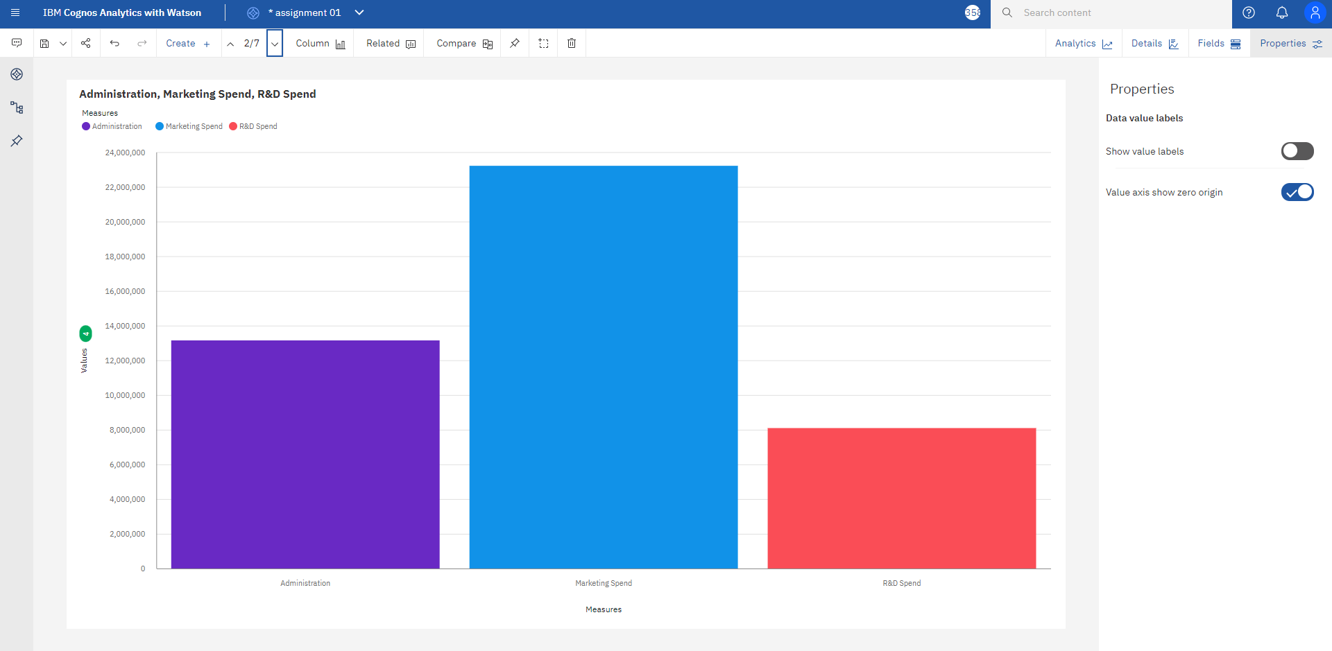

Slide 4
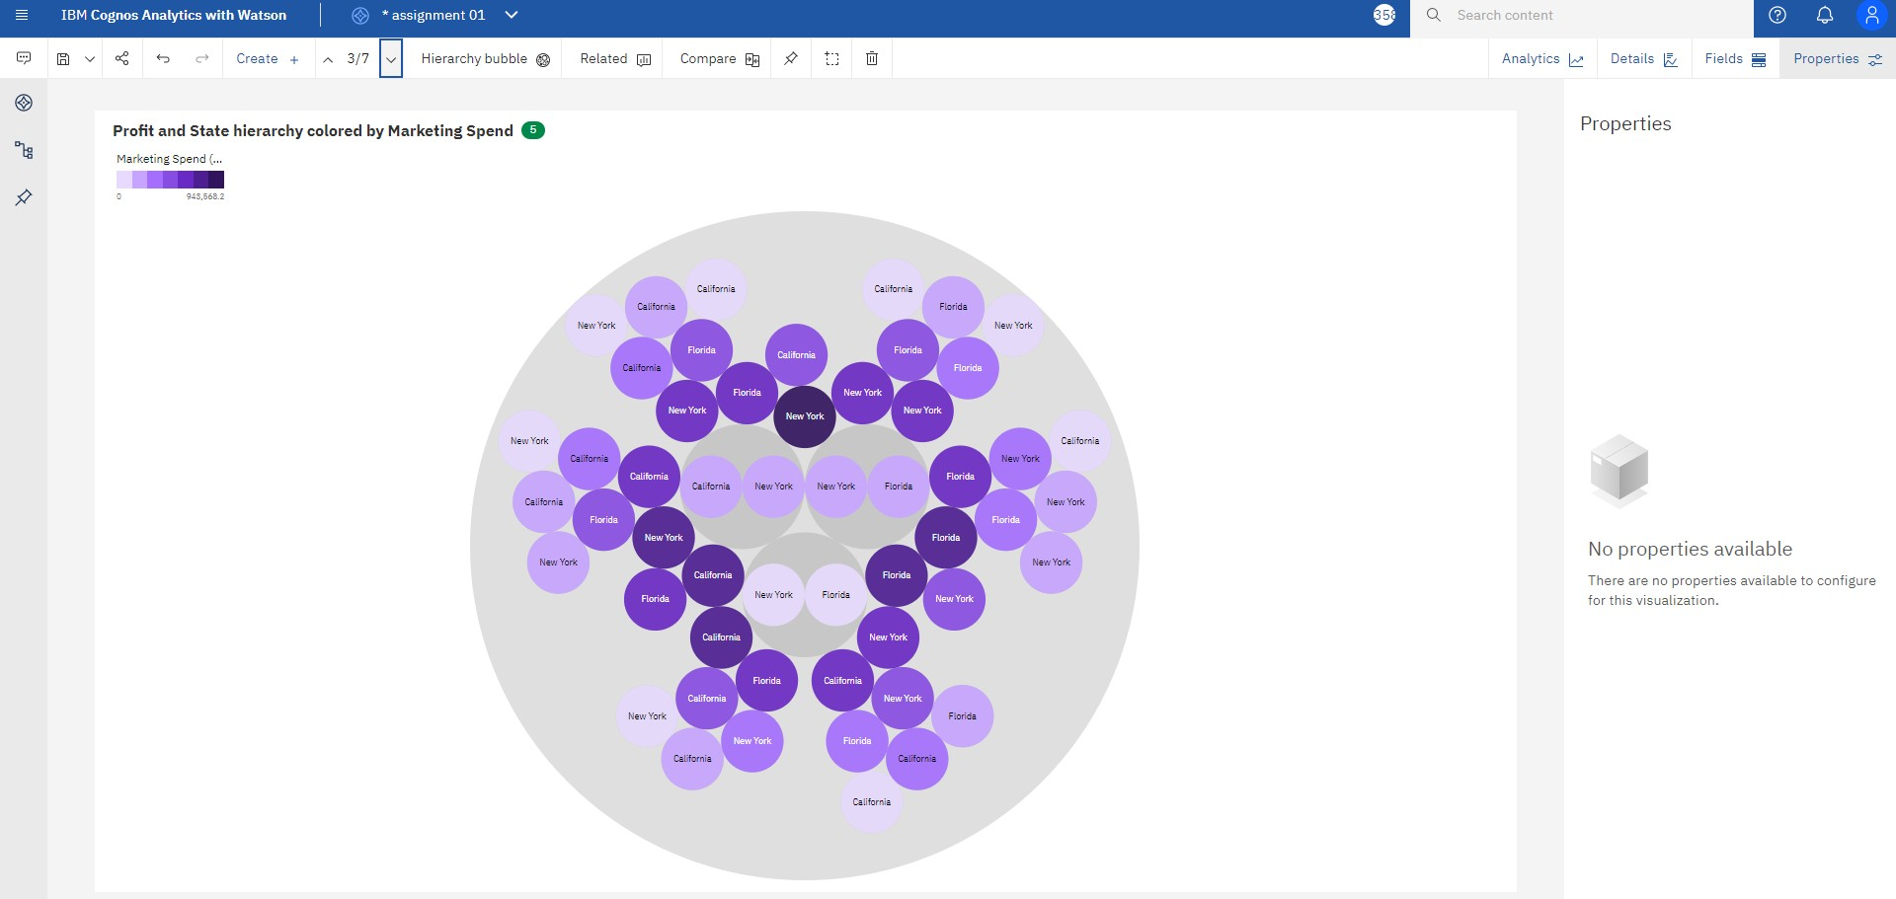

Slide 5
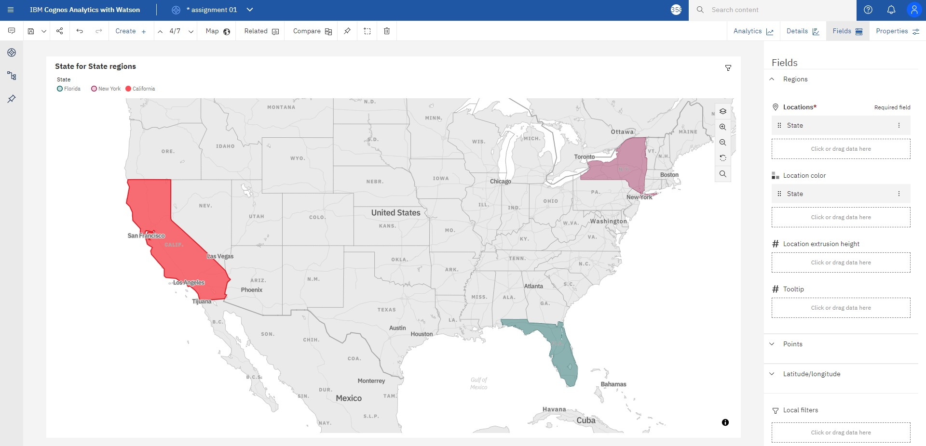

Slide 6
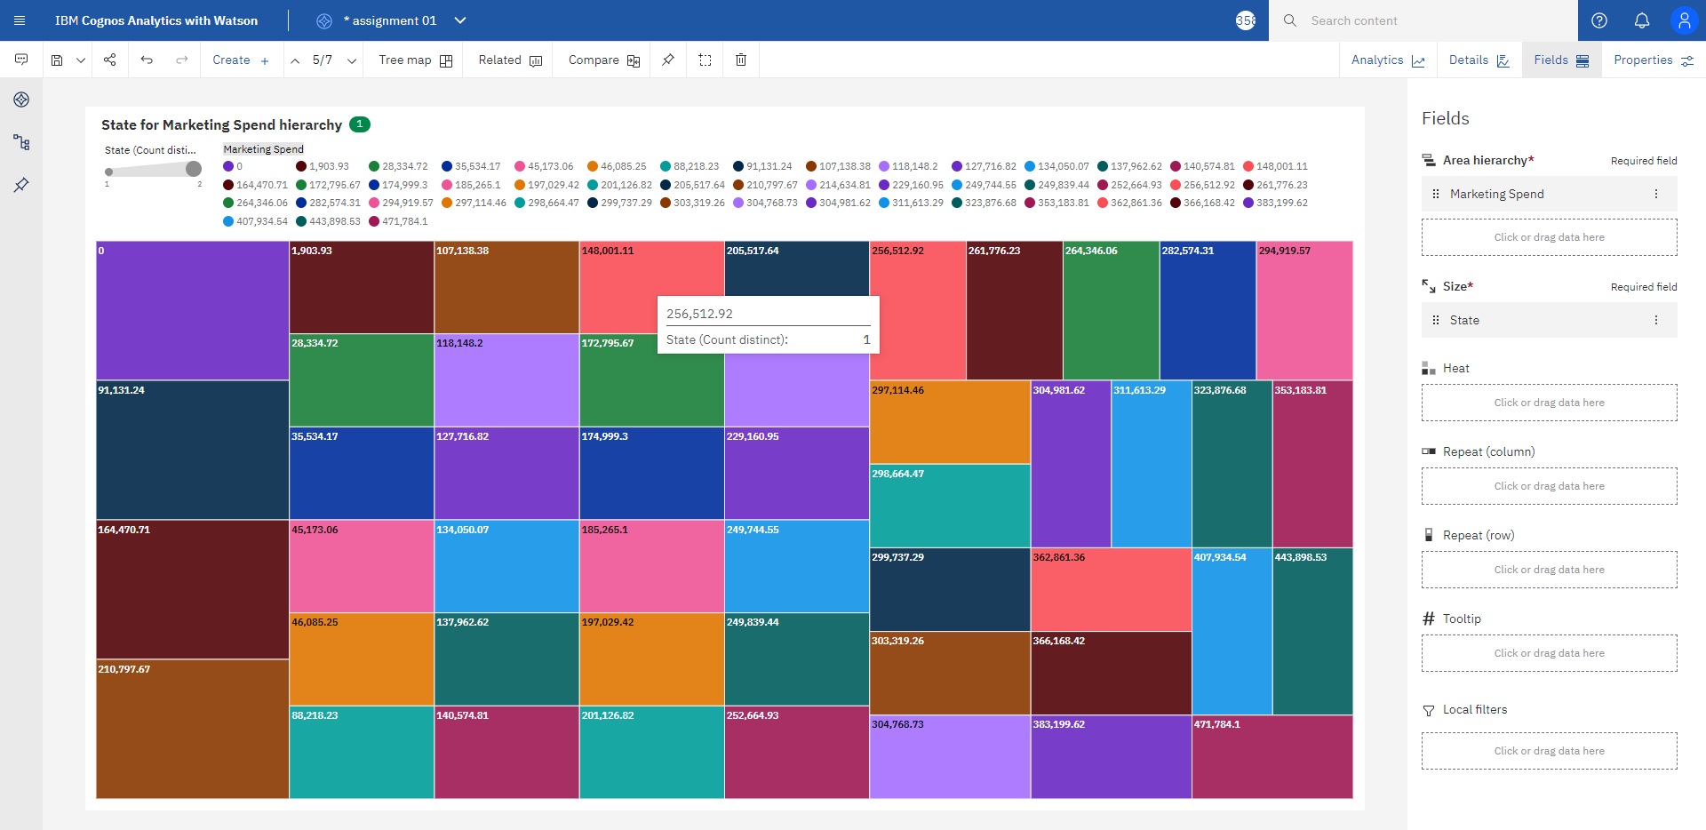

Slide 7
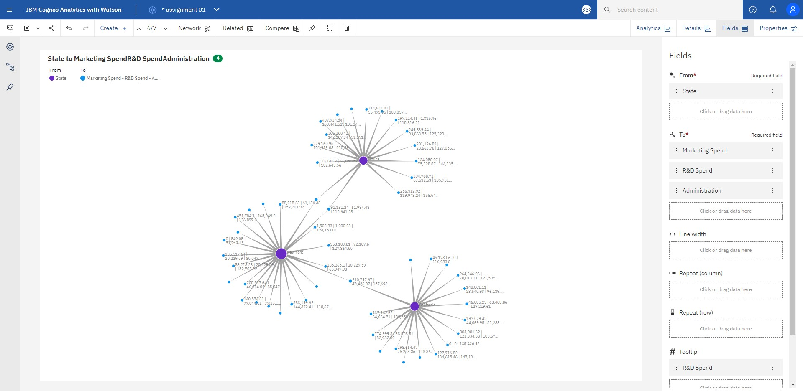

Slide 8
